Slide 1

Math's 7
Differentiation 2

Slide 2
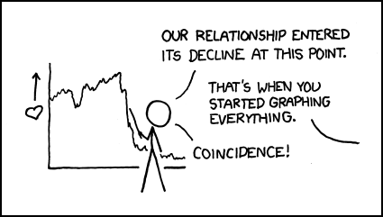
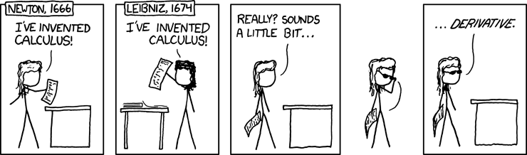
Differentiation

Slide 3
Differentiation
In the last lecture we covered the basic major rules of differentiation.
Now we will see some of the uses and more complicated rules.

Slide 4
Differentiation
Let’s start with a use:
Marginal analysis is a form of calculus that is used by banks to estimate the profits of an item or business in the future.
A derivative of the profit is taken to then forward estimate what will be the profit in the future.

Slide 5
Differentiation
Let’s start with a use:
Marginal analysis is a form of calculus that is used by banks to estimate the profits of an item or business in the future.
A derivative of the profit is taken to then forward estimate what will be the profit in the future.

Slide 6
Differentiation
Marginal profit is the derivative of profit.
Profit is calculated by revenue – costs.
p(f) = r(x) – c(x)
p’(f) = r’(x) – c’(x)

Slide 7
Differentiation
Lets give it a go:
Say we have a company that makes a product.
For each unit sold they make £50
The cost of each unit is £10 but reduces by 10% for each 100 units made. Then there is a cost of marketing which is a fixed £500

Slide 8
Differentiation
For each unit sold they make £50
There is a variable cost of each unit of 10x - 0.1x². Then there is a cost of marketing which is a fixed £500
So let’s make an equation
Profit = 50x – 10x -0.1x² + 500

Slide 9
Differentiation
So let’s make an equation
Profit = 50x – 10x -0.1x² + 500
Marginal profit = 50 – 10 – 0.2x

Slide 10
Differentiation
So let’s make an equation
Profit = 50x – 10x -0.1x² + 500
Marginal profit = 50 – 10 – 0.2x
So our company wants to know how much profits will change by increasing production from 200 to 201 units.

Slide 11
Differentiation
Plug 200 into the equation
Profit = 50x – 10x -0.1x² + 500
Marginal profit = 50 – 10 – 0.2 * 200

Slide 12
Differentiation
Plug 200 into the equation
Profit = 50x – 10x -0.1x² + 500
Marginal profit = 50 – 10 – 40

Slide 13
Differentiation
Plug 200 into the equation
Profit = 50x – 10x -0.1x² + 500
Marginal profit = 0
We just did a single step in a differential equation.

Slide 14
Differentiation
Another use of differentiation is to approximate a linear equation of a curve so you get a general idea of the trend.
This is used in rare cases where the tangent line and the function line have very similar plots.
This pretty much identical to what we just did.

Slide 15
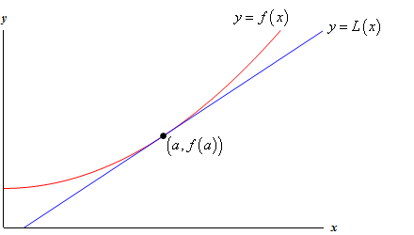
Differentiation
Lets take a look at this function and its tangent line.

Slide 16
Differentiation
The tangent line is fairly close to the graph of the function.

Slide 17
Differentiation
From this we can see that at values close to the tangent point the tangent line would predict values on the function closely.

Slide 18
Differentiation
First we need to know how to find the tangent to a curve at any specific point.

Slide 19
Differentiation
First we need to know how to find the tangent to a curve at any specific point.
This is fairly easy with our knowledge of derivatives and functions.
We know the derivative is the gradient of a tangent line at a specific point so we just need to sub those points into a linear equation.

Slide 20
Differentiation
Let’s try a simple one.
A function with equation x² + 2x -4

Slide 21
Differentiation
Let’s try a simple one.
A function with equation x² + 2x -4
The derivation is 2x +2

Slide 22
Differentiation
Let’s try a simple one.
A function with equation x² + 2x -4
The derivation is 2x +2
So lets get the y when when x = 8

Slide 23
Differentiation
A function with equation x² + 2x -4
The derivation is 2x +2
So lets get the y when when x = 8
64 + 16 – 4

Slide 24
Differentiation
A function with equation x² + 2x -4
The derivation is 2x +2
So lets get the y when when x = 8
76

Slide 25
Differentiation
A function with equation x² + 2x -4 where x = 8, y =76
The derivation is 2x +2
Now lets find the gradient at x = 8

Slide 26
Differentiation
A function with equation x² + 2x -4 where x = 8, y =76
The derivation is 2x +2
Now lets find the gradient at x = 8
16 + 2

Slide 27
Differentiation
A function with equation x² + 2x -4 where x = 8, y =76
The derivation is 2x +2
Now lets find the gradient at x = 8
18

Slide 28
Differentiation
A function with equation x² + 2x -4 where x = 8, y =76
So we have the equation for the tangent line at point 8,76
76 = 18 * 8 + c

Slide 29
Differentiation
A function with equation x² + 2x -4 where x = 8, y =76
So we have the equation for the tangent line at point 8,76
76 = 18 * 8 + c
c = -68

Slide 30
Differentiation
A function with equation x² + 2x -4 where x = 8, y =76
So we have the equation for the tangent line at point 8,76
76 = 18 * 8 + c
So y = 18x - 68

Slide 31
Differentiation
A function with equation x² + 2x -4 where x = 8, y =76
So we have the equation for the tangent line at point 8,76
So y = 18x – 68
Now lets look at points on this tangent

Slide 32
Differentiation
A function with equation x² + 2x -4 at x = 8, y =76
y = 18x – 68 where at x =8, y = 76
Now lets look at points on this tangent where x = 9
81 + 18 – 4 = 95
Not bad!
18 * 9 – 68 = 94

Slide 33
Differentiation
A function with equation x² + 2x -4 at x = 8, y =76
y = 18x – 68 where at x =8, y = 76
But lets look at a point a bit further away like x = 1
1 + 2 – 4 = -1
Not so good!
18 – 68 = -50

Slide 34
Differentiation
Finding the roots.
We’ve found roots of quadratic equations before but we can do the same with equations using the derivative.
This is called the Newton Method.

Slide 35
Differentiation
The Newton Method.
Using the tangent line to a curve we can get iteratively closer to the root of the equation.
Using what we did before we take a tangent line at a point, find where it crosses zero and then the tangent line of that x value in our original function.

Slide 36
Differentiation
The Newton Method.

Slide 37
Differentiation
This is in essence creating a series of values getting closer and closer to
y = 0

Slide 38

Differentiation
This series takes the formula:
$$x_{n+1}=x_{n}−\frac{f(x_{n})}{f′(x_{n})}$$

Slide 39

Differentiation
Lets try it out on a function: 4x² + 2x -7
$$x_{n+1}=x_{n}−\frac{f(x_{n})}{f′(x_{n})}$$

Slide 40

Differentiation
Lets try it out on a function: 4x² + 2x -7
$$x_{n+1}=x_{n}−\frac{f(x_{n})}{f′(x_{n})}$$
Throw in a value of x to start

Slide 41

Differentiation
Lets try it out on a function: 4x² + 2x -7
$$x_{n+1}=2−\frac{f(2)}{f′(2)}$$
Throw in a value of x to start lets say x =2

Slide 42

Differentiation
Lets try it out on a function: 4x² + 2x -7
$$x_{n+1}=2−\frac{4 ×4+8 −7}{8 ×2+2}$$
Work out the value

Slide 43

Differentiation
Lets try it out on a function: 4x² + 2x -7
$$x_{n+1}=2−\frac{17}{19}$$
Work out the value

Slide 44

Differentiation
Lets try it out on a function: 4x² + 2x -7
$$x_{n+1}=2−0.8947$$
Work out the value

Slide 45

Differentiation
Lets try it out on a function: 4x² + 2x -7
$$x_{n+1}=1.1053$$
Work out the value

Slide 46

Differentiation
Lets try it out on a function: 4x² + 2x -7
$$x_{n+1}=1.1053$$
Now plug this in to our original series equation

Slide 47

Differentiation
Lets try it out on a function: 4x² + 2x -7
$$x_{n+1}=1.1053−\frac{f(1.1053)}{f′(1.1053)}$$

Slide 48

Differentiation
Lets try it out on a function: 4x² + 2x -7
$$x_{n+1}=1.1053−\frac{4 ×{1.1053}^{2}+2 ×1.1053 −7}{8 ×1.1053+2}$$

Slide 49

Differentiation
Lets try it out on a function: 4x² + 2x -7
$$x_{n+1}=1.1053−\frac{0.0974}{10.8424}$$

Slide 50

Differentiation
Lets try it out on a function: 4x² + 2x -7
$x_{n+1}=1.1053−$0.008898

Slide 51
Differentiation
Lets try it out on a function: 4x² + 2x -7
$x_{n+1}=1.1053−$0.008898

Slide 52
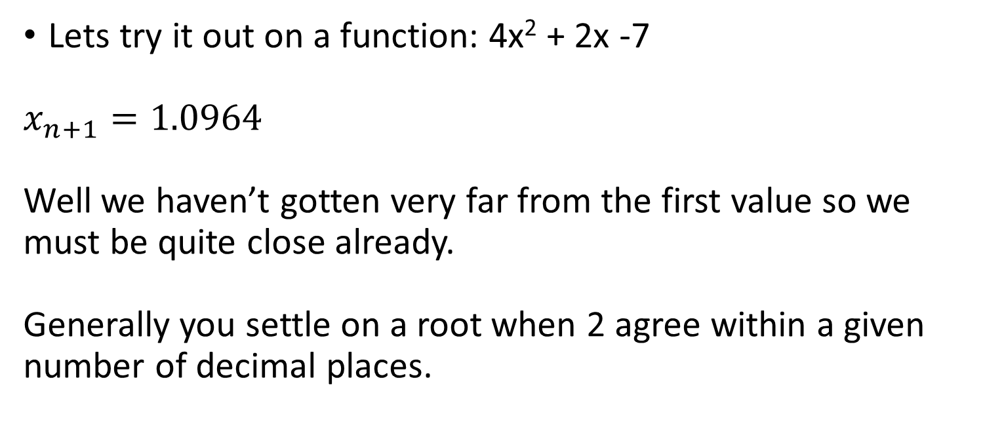
Differentiation
Lets try it out on a function: 4x² + 2x -7
$$x_{n+1}=1.0964$$
Well we haven’t gotten very far from the first value so we must be quite close already.
Generally you settle on a root when 2 agree within a given number of decimal places.

Slide 53

Differentiation
Lets try it out on a function: 4x² + 2x -7
$$x_{n+1}=1.0964$$
Lets go one more.

Slide 54

Differentiation
Lets try it out on a function: 4x² + 2x -7
$$x_{n+1}=1.0964−\frac{f(1.096)}{f′(1.0964)}$$
Lets skip to the answer.

Slide 55
Differentiation
Lets try it out on a function: 4x² + 2x -7
$$x_{n+1}=1.0964−\frac{f(1.096)}{f′(1.0964)}$$
Lets skip to the answer.

Slide 56

Differentiation
Lets try it out on a function: 4x² + 2x -7
$$x_{n+1}=1.0961$$
Lets skip to the answer.

Slide 57
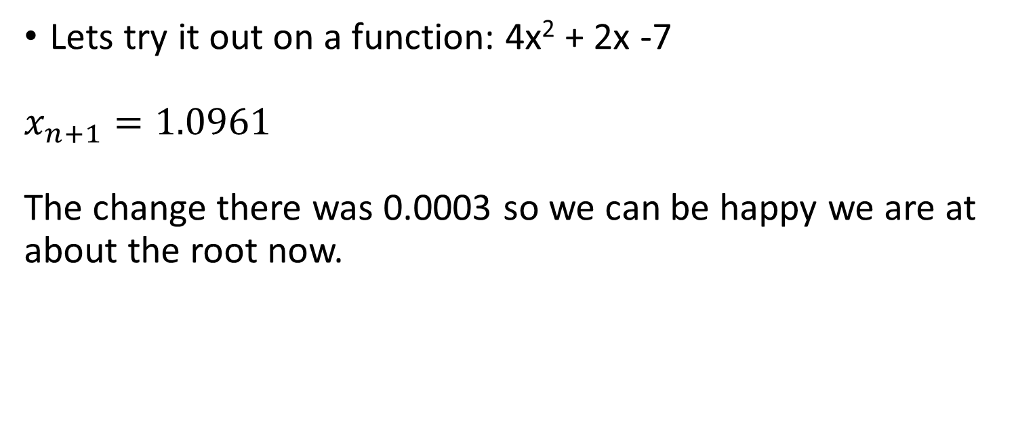
Differentiation
Lets try it out on a function: 4x² + 2x -7
$$x_{n+1}=1.0961$$
The change there was 0.0003 so we can be happy we are at about the root now.

Slide 58
Differentiation
Composite functions are functions that combine two functions where one is a dependency on the other.
In other words you have one function which maps x -> y and another function that goes y -> z the composite function goes from x -> z
We have touched on these briefly but not discussed the notation

Slide 59
Differentiation
A composite function is given with the notation:
f(x) ○ g(x)
This simply means you apply the function f to the output of function g.

Slide 60
Differentiation
Differentiating composite functions uses something called the chain rule:
The differential of the composite function F’(x) from f(x) and g(x) =
F’(x) = f’(g(x)g’(x)

Slide 61
Differentiation
Differentiating composite functions uses something called the chain rule:
The differential of the composite function F’(x) from f(x) and g(x) =
F’(x) = f’(g(x)g’(x)
So it is the derivative of the function f applied to the output of the function g times the derivative of the function g

Slide 62
Differentiation
Lets try it:
F’(x) = f’(g(x)g’(x)
F(x) is the composite function of f(x) = 2x -3 and g(x) = 4x³
So lets plug it into the chain rule to get our derivative.

Slide 63
Differentiation
Lets try it:
F’(x) = f’(4x³)* g’(x)
F(x) is the composite function of f(x) = 2x -3 and g(x) = 4x³
lets work out our derivatives.

Slide 64
Differentiation
Lets try it:
F’(x) = f’(4x³)* g’(x)
F(x) is the composite function of f(x) = 2x -3 and g(x) = 4x³
f’(x) = 2 and g’(x) = 12x²

Slide 65
Differentiation
Lets try it:
F’(x) = f’(4x³)* g’(x)
F(x) is the composite function of f(x) = 2x -3 and g(x) = 4x³
f’(x) = 2 and g’(x) = 12x²
So plug them in

Slide 66
Differentiation
Lets try it:
F’(x) = 2 * 4x³ * 12x²
F(x) is the composite function of f(x) = 2x -3 and g(x) = 4x³
f’(x) = 2 and g’(x) = 12x²
So plug them in

Slide 67
Differentiation
Lets try it:
F’(x) = 96x⁵
F(x) is the composite function of f(x) = 2x -3 and g(x) = 4x³
f’(x) = 2 and g’(x) = 12x²
So plug them in

Slide 68
Differentiation
There is a special case of the chain rule when one function is the other function brought to a power:
This is called the general power rule:
If we have a composite function which is f(x) = (g(x))^{n} we apply the rules we have learned before combined

Slide 69
Differentiation
There is a special case of the chain rule when one function is the other function brought to a power:
This is called the general power rule:
If we have a composite function which is f(x) = (g(x))^{n} we apply the rules we have learned before combined

Slide 70
Differentiation
If we have a composite function which is f(x) = (g(x))^{n}
So if we have a function which is f(x)= g(x)⁴ we have learnt from our previous differentiation and the chain rule that we need to combine rules.
f’(x) = 4g(x)³ and with our chain rule?

Slide 71
Differentiation
If we have a composite function which is f(x) = (g(x))^{n}
So if we have a function which is f(x)= g(x)⁴ we have learnt from our previous differentiation and the chain rule that we need to combine rules.
f’(x) = 4g(x)³ and with our chain rule?
f’(x) = 4g(x)³ * g’(x)

Slide 72
Differentiation
f’(x) = 4g(x)³ * g’(x)
We actually just applied the chain rule as normal but this special case is called the general power rule.

Slide 73
Differentiation
f’(x) = 4g(x)³ * g’(x)
We actually just applied the chain rule as normal but this special case is called the general power rule.

Slide 74
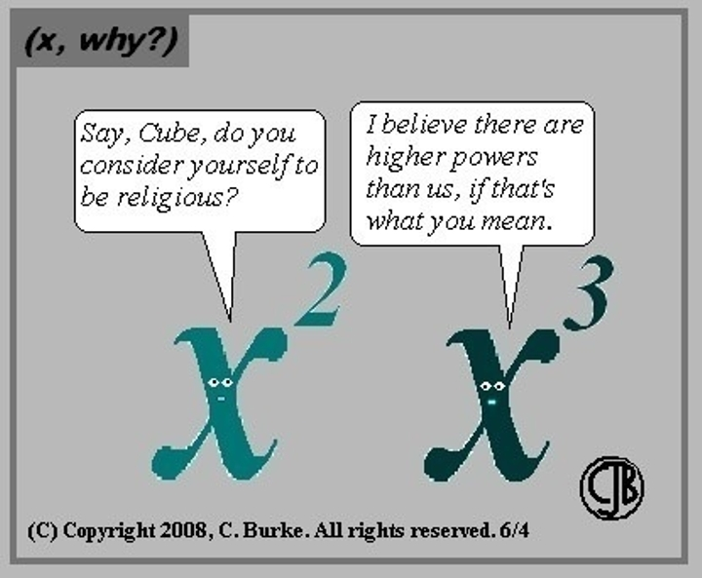
Higher Order Derivatives

Slide 75
Higher Order Derivatives
So we have differentiated lots of things but you may have noticed that sometimes when we differentiate a function we get another function.
What if we want to know what that function differentiates to?
These are called higher order derivatives.

Slide 76
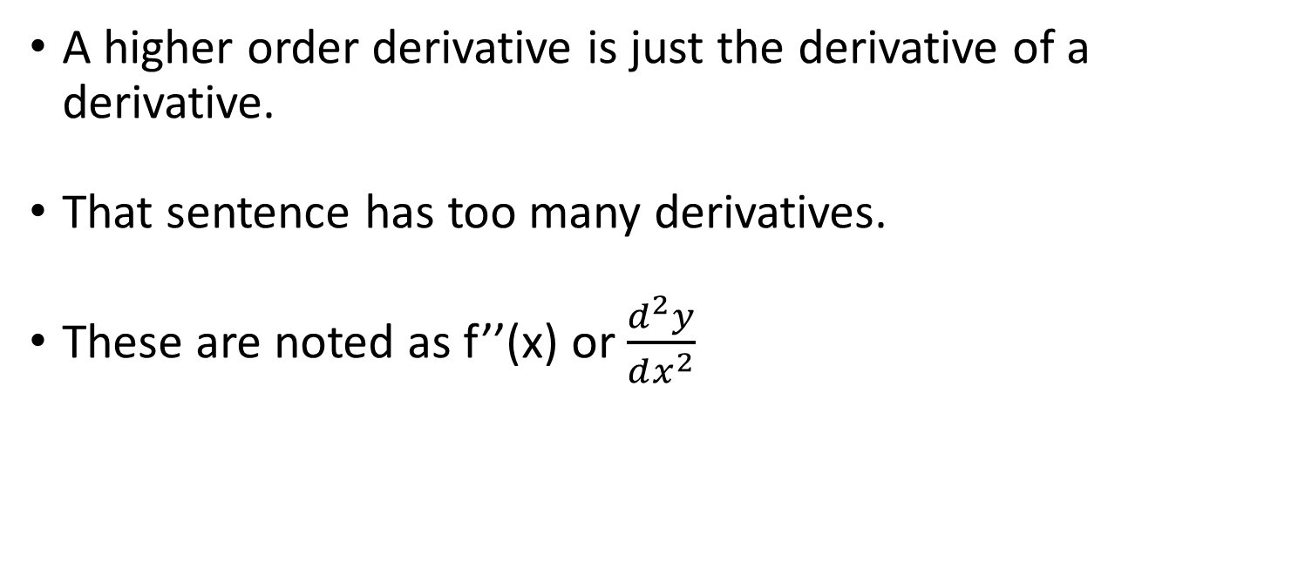
Higher Order Derivatives
A higher order derivative is just the derivative of a derivative.
That sentence has too many derivatives.
These are noted as f’’(x) or $\frac{d^{2}y}{dx^{2}}$

Slide 77

Higher Order Derivatives
f’’(x) or $\frac{d^{2}y}{dx^{2}}$
To do these we just use all the rules we have already learnt!

Slide 78

Higher Order Derivatives
Let’s give one a go!
$$y=3x^{3}+2x^{2} −6x+4$$

Slide 79

Higher Order Derivatives
Let’s give one a go!
$$y^{′}=3 ×3x^{2}+2×2x^{}−6$$

Slide 80

Higher Order Derivatives
Let’s give one a go!
$$y^{′}=9x^{2}+4x −6$$

Slide 81

Higher Order Derivatives
Ok we have our first differential but we want the derivative of this:
$$y^{′}=9x^{2}+4x −6$$

Slide 82

Higher Order Derivatives
Ok we have our first differential but we want the derivative of this:
$$y^{′′}=2 ×9x^{}+4$$

Slide 83

Higher Order Derivatives
This is our second order derivative.
$$y^{′′}=18x+4$$

Slide 84

Higher Order Derivatives
We can go further if we want!
$$y^{′′}=18x+4$$

Slide 85

Higher Order Derivatives
We can go further if we want!
$$y^{′′′}=18$$

